Slide 1
Connect Plus
TEAM 7:
TEAM MEMBERS:
Kranthi Kiran Reddy Vanga
Bhavaz Akula
Gowtham Varma Vegesna
Md Usman Gani Syed

Slide 2
WWW of our Project
Who am I?
I am a simple Chat Application built on Angular.
What can I do?
I can help you in chatting.
Why am I?
I will maintain privacy and help you chat anonymously with your alias names

Slide 3
FEATURES
Signup and Login users
Store login data in backend using Server side Node Js, MongoDB
Chat anonymously using alias names
Multiple users login and Chat
Store login session and once the user logs out, his/her login data will be romeved from every other individuals chat.
Used Angular components for each feature.

Slide 4
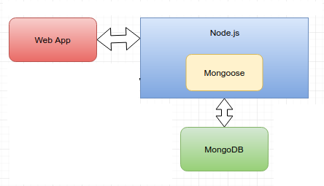
Architecture

Slide 5




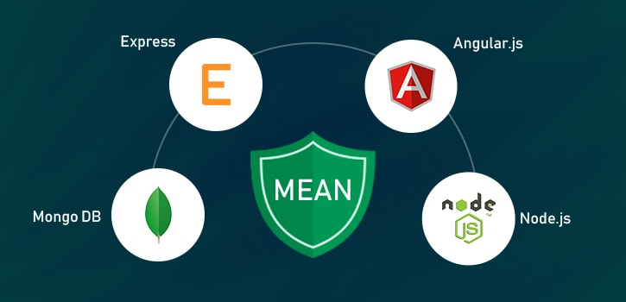

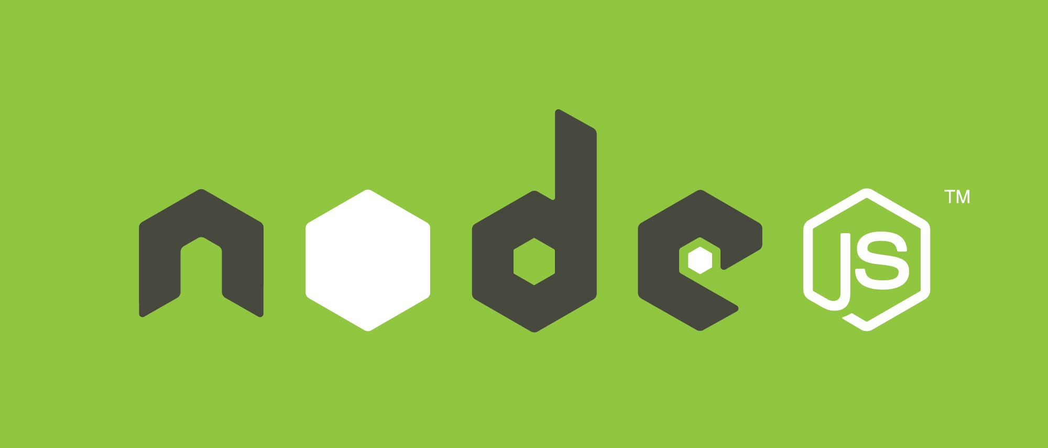
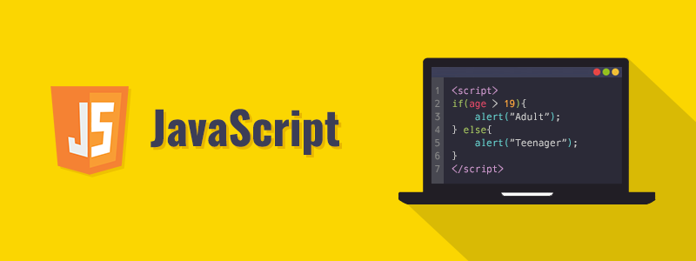

Technologies Used:

Slide 6
Contribution
Kranthi Kiran Reddy – Connect component
Bhavaz Akula – Login component
Gowtham Varma – Registration component
Syed Gani – Database Connection
Everyone - Socket.io

Slide 7
Future Work
Build a comprehensive web chat application.
Create a user profiles for each user
Add calling features
Creating new status component

Slide 8
Reference Links
https://www.npmjs.com/package/mongoose
https://www.npmjs.com/package/express
https://www.npmjs.com/package/socket.io
https://angular.io/tutorial

Slide 9
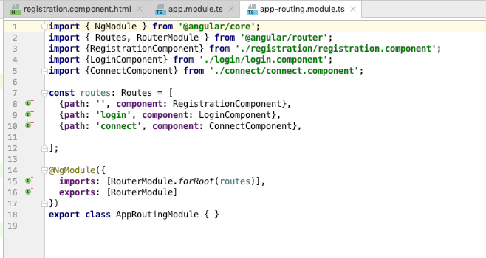
Code: app-routing.module.ts

Slide 10
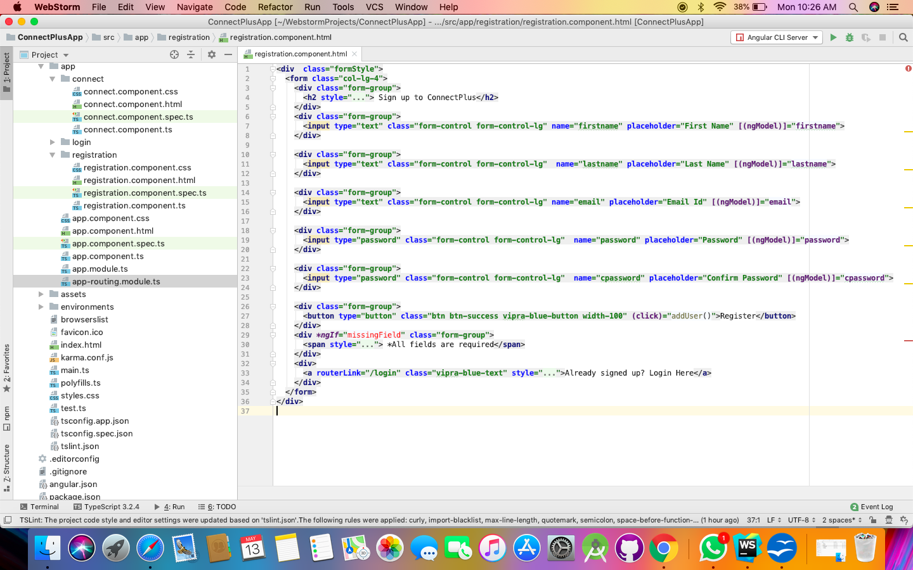
registration.component.html

Slide 11
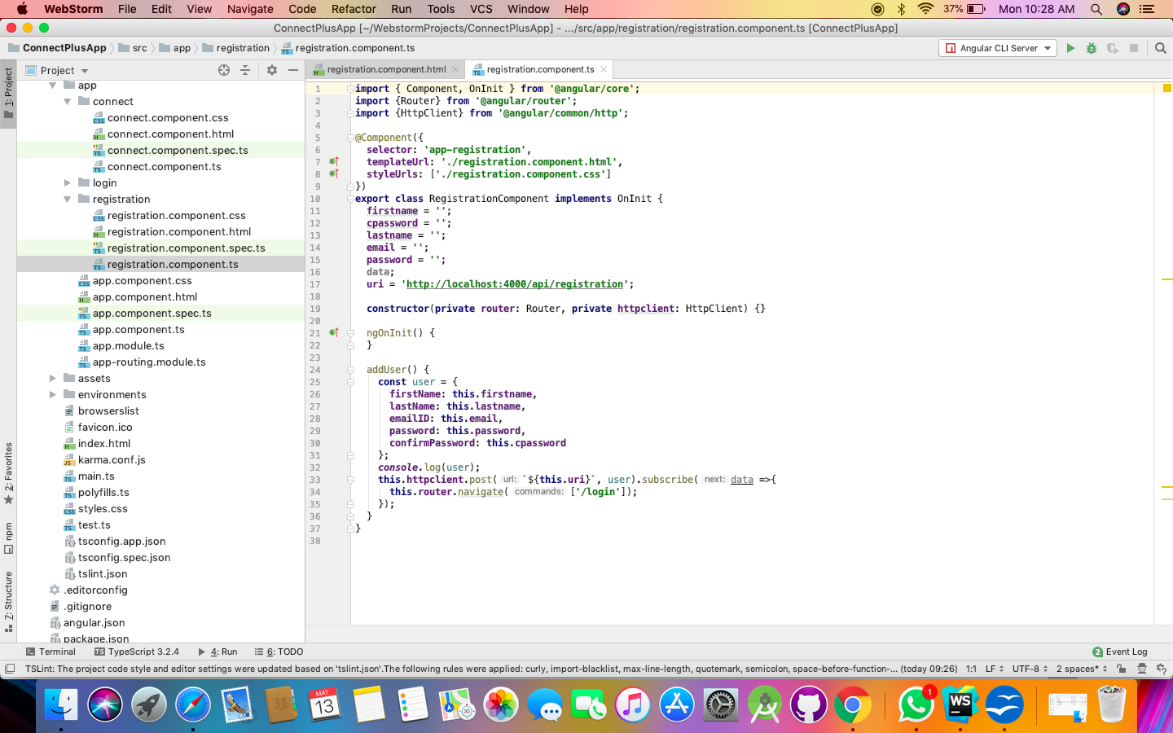
Registration.component.ts

Slide 12
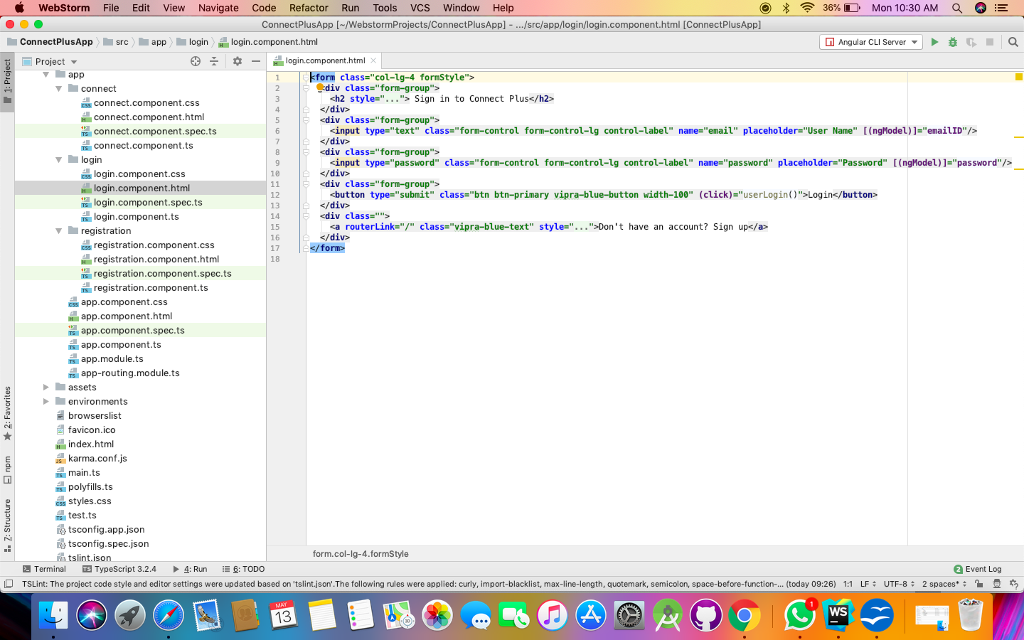
login.component.html

Slide 13
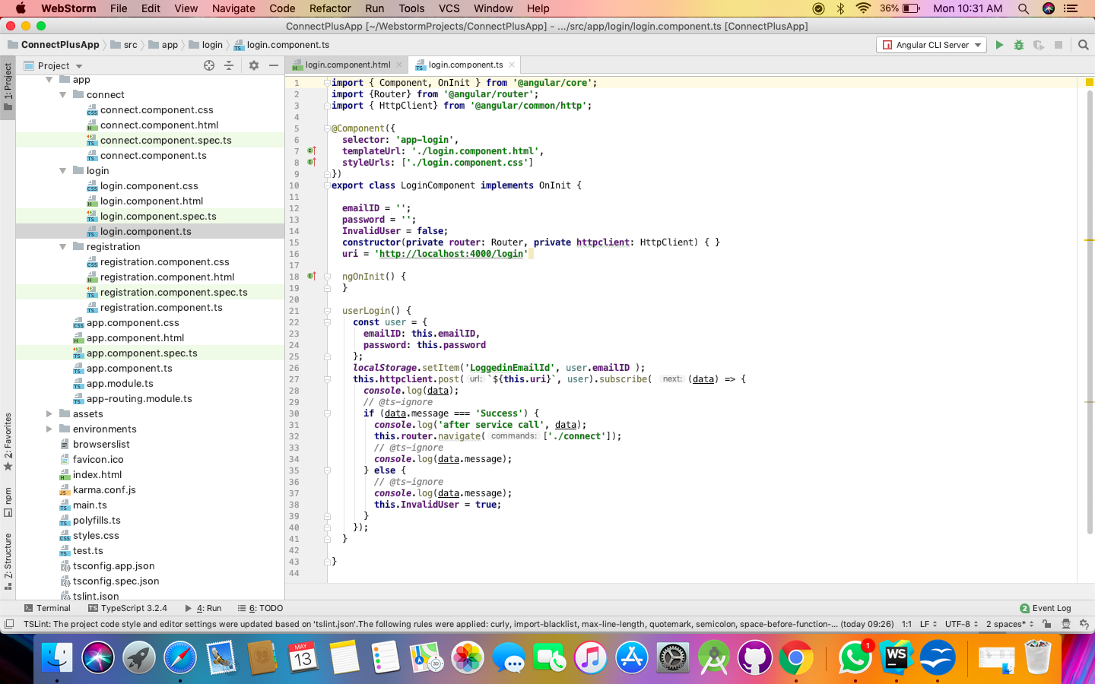
Login.component.ts

Slide 14
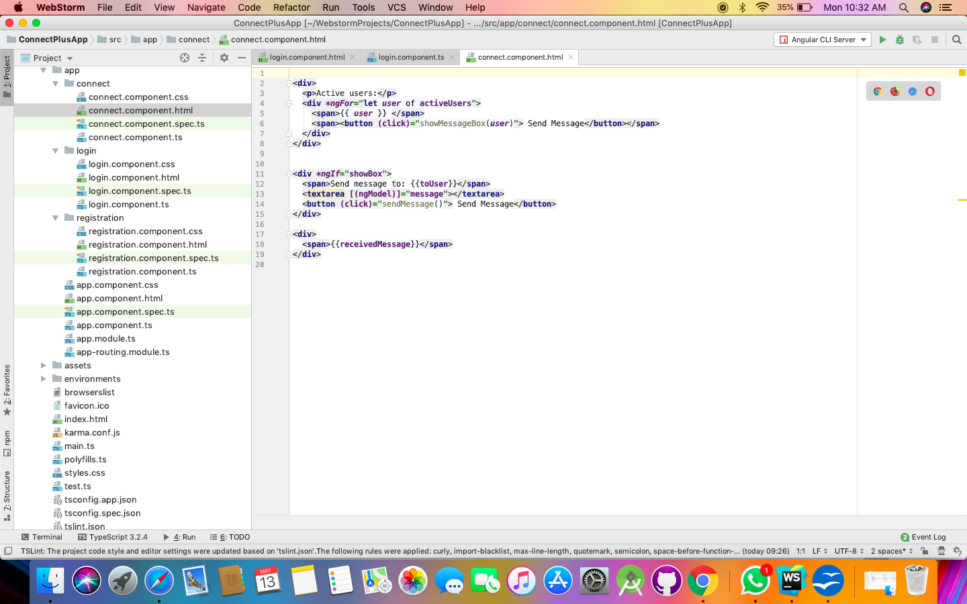
Connect.component.html

Slide 15
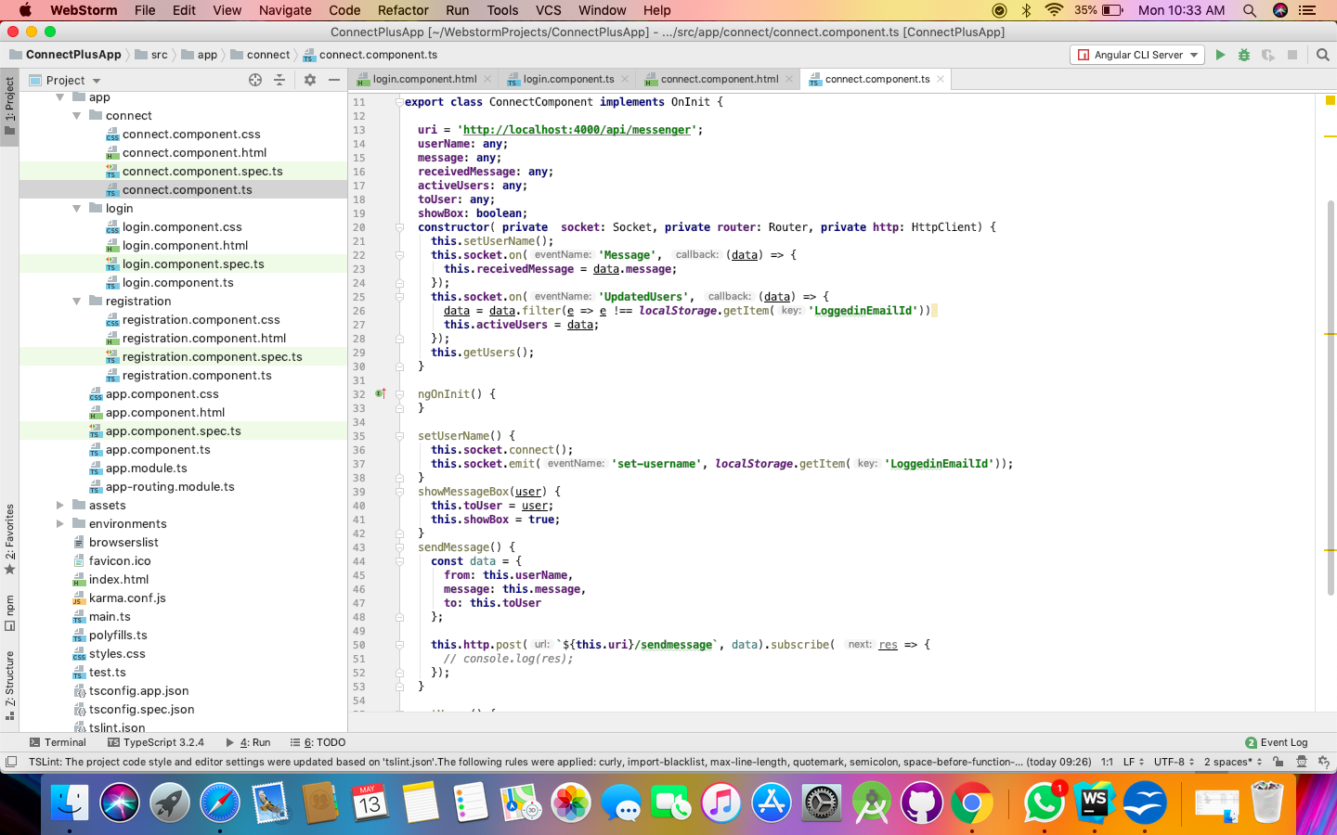
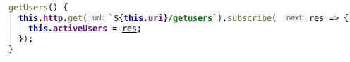
Connect.component.ts

Slide 16
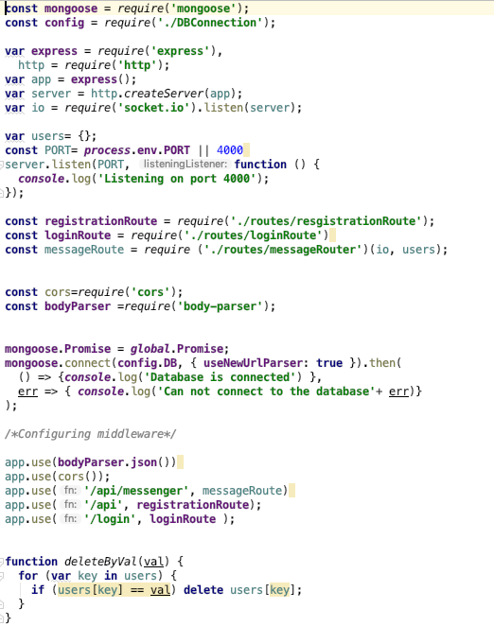
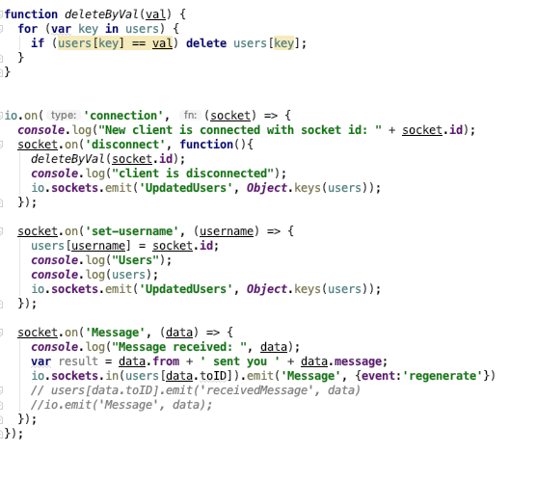
Server.js

Slide 17
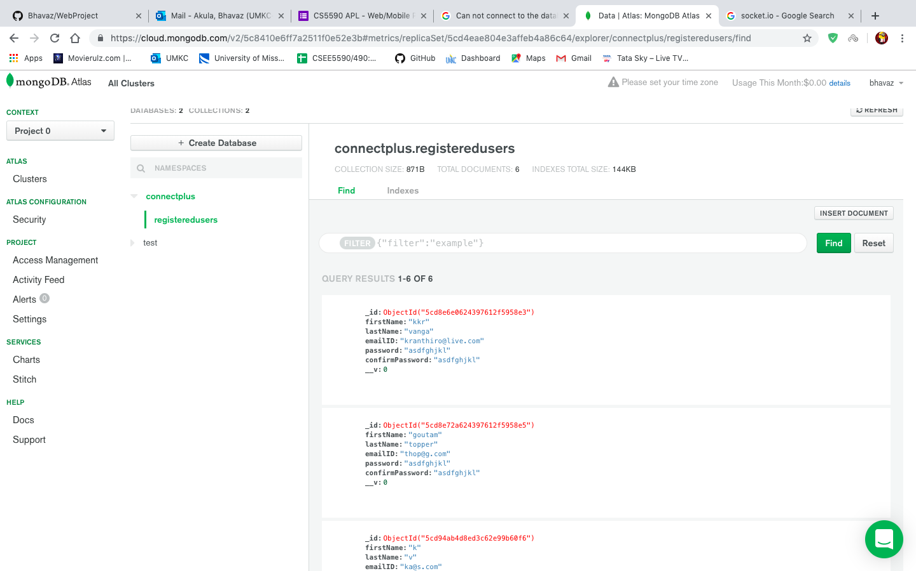
Mongo Cloud Database

Slide 18
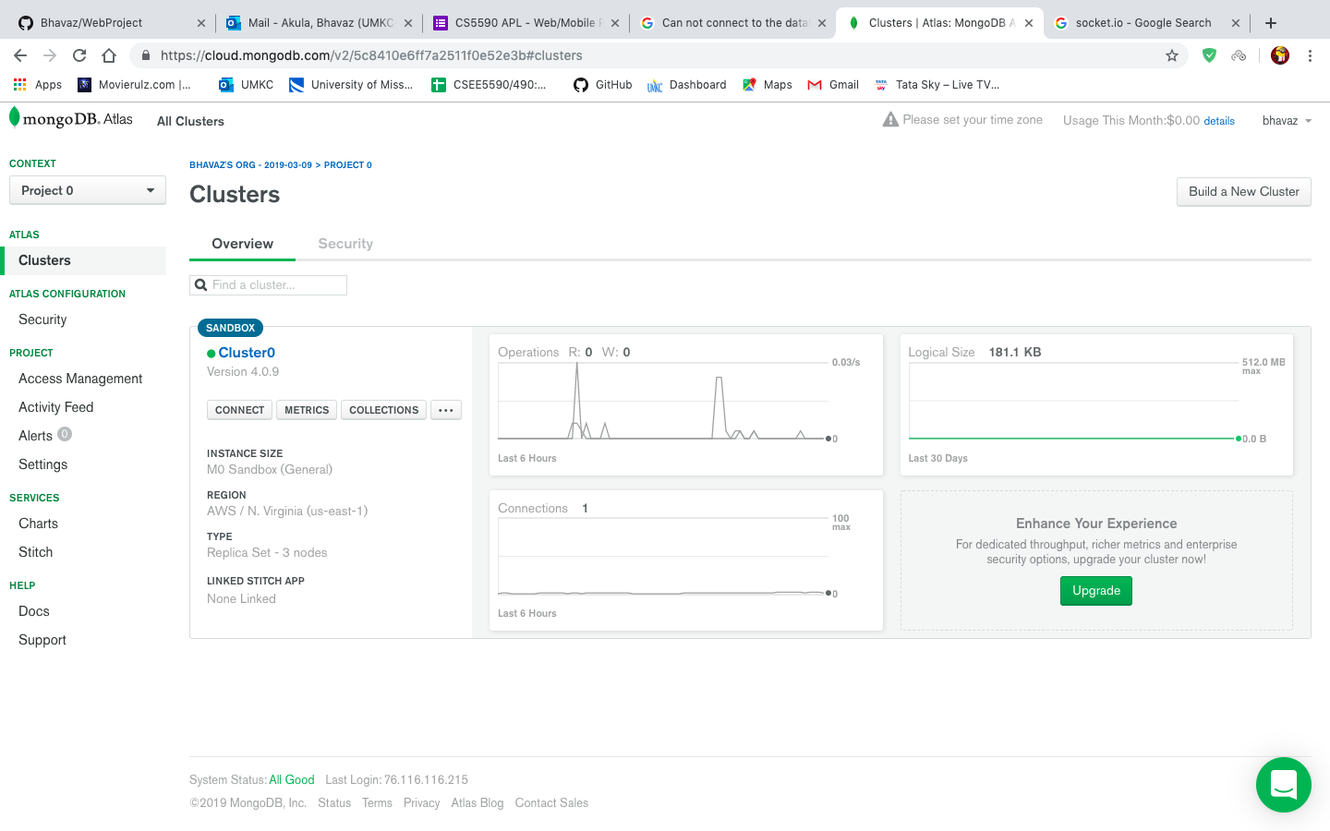
THANK YOU

Slide 19
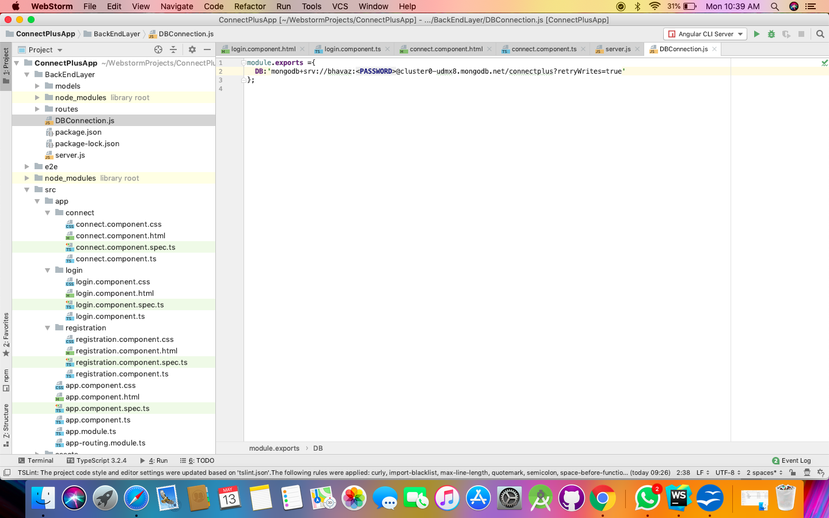
DBconnection.js

Slide 20
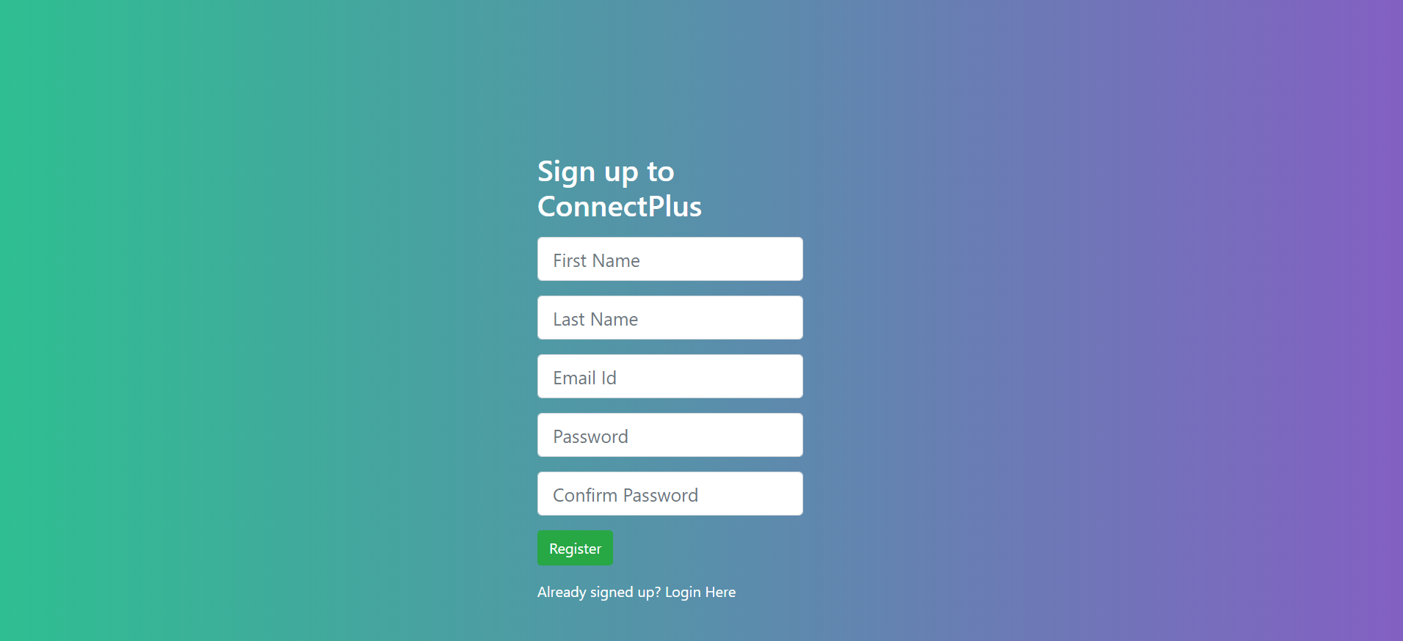
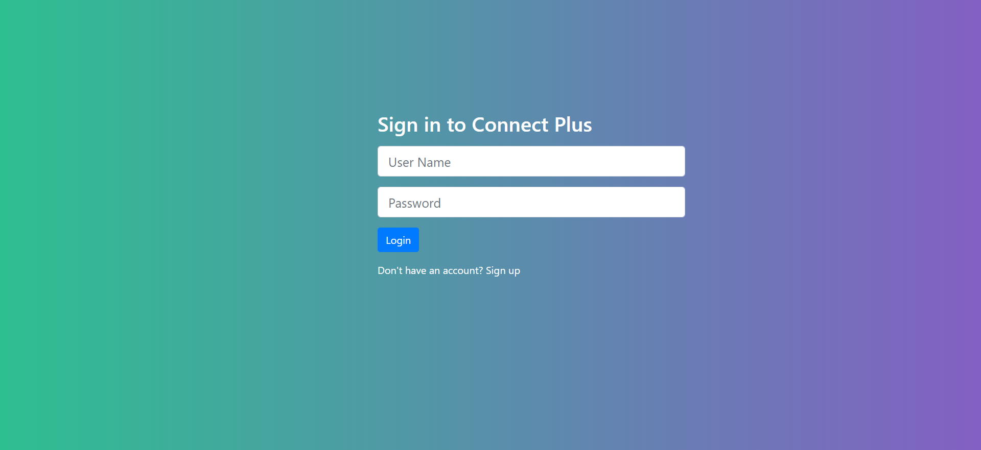

Slide 21
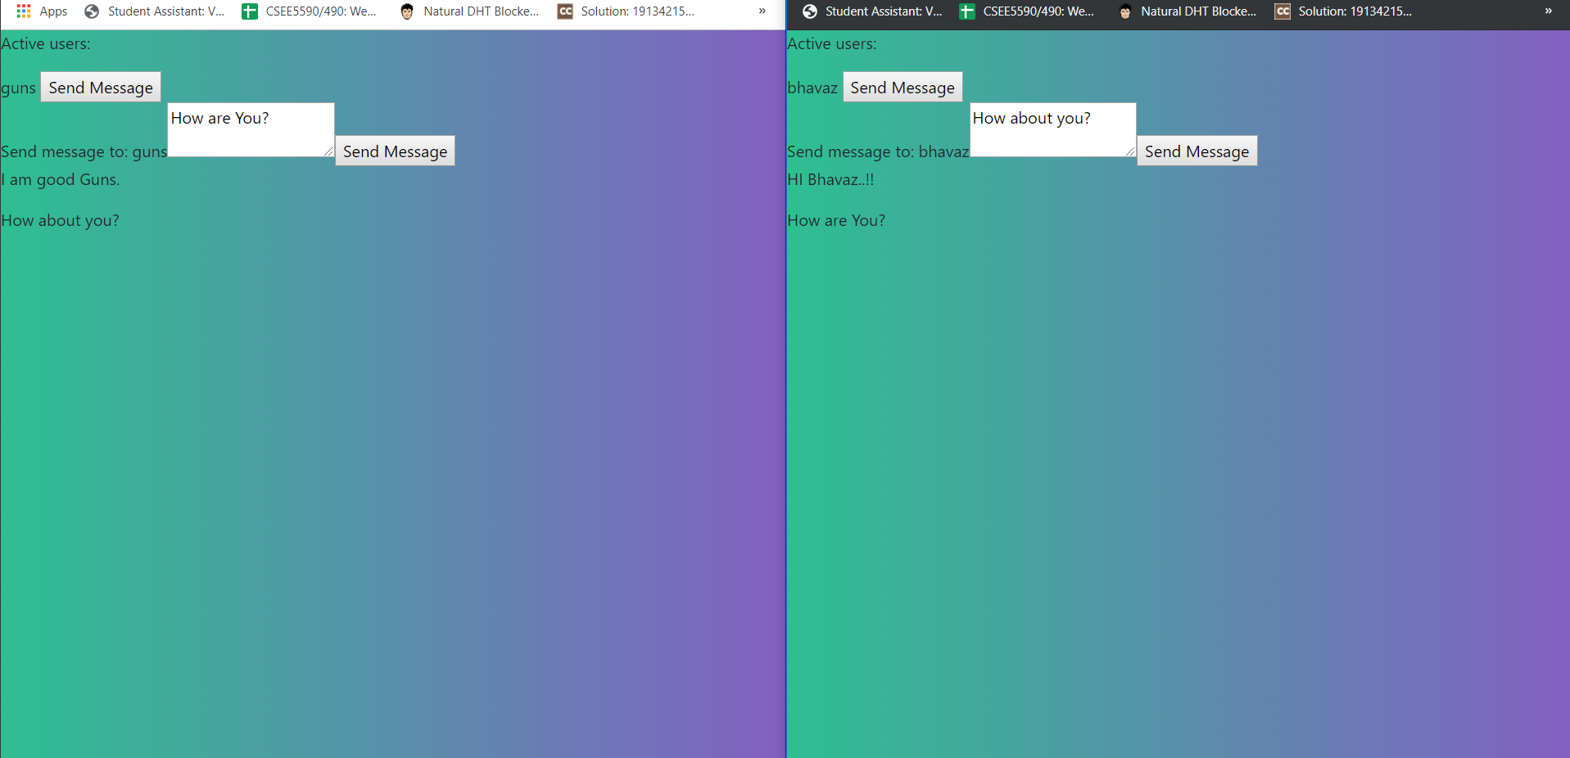

Slide 22
